Slide 1
ARTIFICIAL INTELLIGENCE & MACHINE LEARNING
Session— 3 & 4
Uninformed Search Strategies
A. Senthil, Asst Prof /CSE

Slide 2



AIM
To familiarize students with the concepts of Uninformed search strategies - BFS, DFS, DLS, IDS and Bidirectional Search
INSTRUCTIONAL OBJECTIVES
This session is designed to:
Understand the Concepts of Breadth First Search and Depth First Search
Comprehend the Principle of Uniform cost Search
Understand the concept of Depth Limit Search and Iterative Deepening Search
Understand the Concept of Bidirectional Search
LEARNING OUTCOMES
At the end of this session, you should be able to:
Apply BFS, DFS and Depth limit search techniques
Apply Least cost Search technique
Apply Bidirectional Search technique

Slide 3
Outline
Overview of uninformed search methods
Search strategy evaluation
Complete? Time? Space? Optimal?
Max branching (b), Solution depth (d), Max depth (m)
Search Strategy Components and Considerations
Queue? Goal Test when? Tree search vs. Graph search?

Slide 4
Uninformed search strategies
Uninformed (blind):
You have no clue whether one non-goal state is better than any other. Your search is blind. You don’t know if your current exploration is likely to be fruitful.
Various blind strategies:
Breadth-first search
Uniform-cost search
Depth-first search
Iterative deepening search (generally preferred)
Bidirectional search (preferred if applicable)

Slide 5
Search strategy evaluation
A search strategy is defined by the order of node expansion
Strategies are evaluated along the following dimensions:
Completeness: does it always find a solution if one exists?
Time complexity: number of nodes generated
Space complexity: maximum number of nodes in memory
Optimality: does it always find a least-cost solution?
Time and space complexity are measured in terms of
b: maximum branching factor of the search tree
d: depth of the least-cost solution
m: maximum depth of the state space (may be ∞)

Slide 6
Uninformed search strategies
Queue for Frontier:
FIFO? LIFO? Priority?
Goal-Test:
When inserted into Frontier? When removed?
Tree Search or Graph Search:
Forget Explored nodes? Remember them?

Slide 7
Queue for Frontier
FIFO (First In, First Out)
Results in Breadth-First Search
LIFO (Last In, First Out)
Results in Depth-First Search
Priority Queue sorted by path cost so far
Results in Uniform Cost Search
Iterative Deepening Search uses Depth-First
Bidirectional Search can use either Breadth-First or Uniform Cost Search

Slide 8
When to do Goal-Test? When generated? When popped?
Do Goal-Test when node is popped from queue
IF you care about finding the optimal path
AND your search space may have both short expensive and long cheap paths to a goal.
Guard against a short expensive goal.
E.g., Uniform Cost search with variable step costs.
Otherwise, do Goal-Test when is node inserted.
E.g., Breadth-first Search, Depth-first Search, or Uniform Cost search when cost is a non-decreasing function of depth only (which is equivalent to Breadth-first Search).
REASON ABOUT your search space & problem.
How could I possibly find a non-optimal goal?

Slide 9
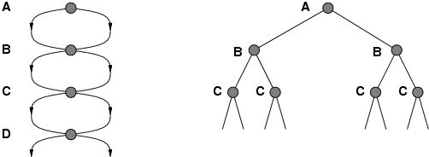
Repeated states
Failure to detect repeated states can turn a linear problem into an exponential one!
Test is often implemented as a hash table.

Slide 10
Solutions to Repeated States
Graph search
Never explore a state explored before
Must keep track of all possible states (a lot of memory)
E.g., 8-puzzle problem, we have 9! = 362,880 states
Memory-efficient approximation for DFS/DLS
Avoid states on path to root: avoid looping paths.
Graph search optimality/completeness
Same as Tree search; just a space-time trade-off
B
faster but memory inefficient
S
C
S
State Space
B
C
C
S
B
S
Example of a Search Tree

Slide 11
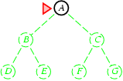
Breadth-first search
Expand shallowest unexpanded node
Frontier (or fringe): nodes in queue to be explored
Frontier is a first-in-first-out (FIFO) queue, i.e., new successors go at end of the queue.
Goal-Test when inserted.
Future= green dotted circles
Frontier=white nodes
Expanded/active=gray nodes
Forgotten/reclaimed= black nodes
Initial state = A
Is A a goal state?
Put A at end of queue.
frontier = [A]

Slide 12
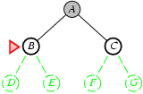
Breadth-first search
Expand shallowest unexpanded node
Frontier is a FIFO queue, i.e., new successors go at end
Expand A to B, C.
Is B or C a goal state?
Put B, C at end of queue.
frontier = [B,C]

Slide 13
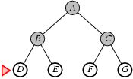
Breadth-first search
Expand shallowest unexpanded node
Frontier is a FIFO queue, i.e., new successors go at end
Expand C to F, G.
Is F or G a goal state?
Put F, G at end of queue.
frontier = [D,E,F,G]

Slide 14
Breadth-first search
Expand shallowest unexpanded node
Frontier is a FIFO queue, i.e., new successors go at end
Expand D to no children.
Forget D.
frontier = [E,F,G]

Slide 15
Breadth-first search
Expand shallowest unexpanded node
Frontier is a FIFO queue, i.e., new successors go at end
Expand E to no children.
Forget B,E.
frontier = [F,G]

Slide 16
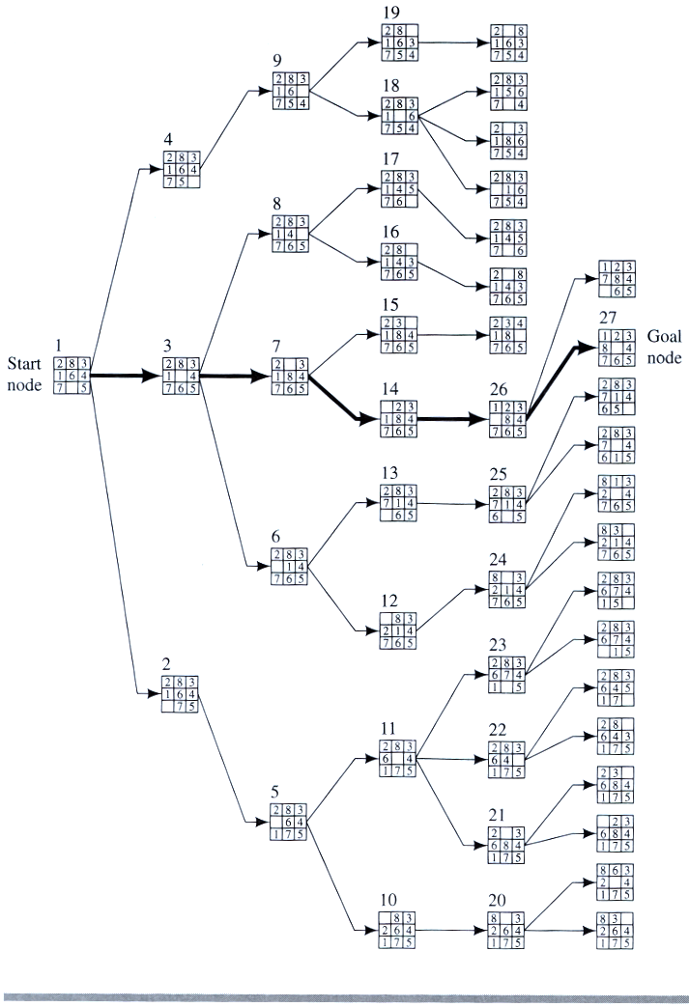
Example
BFS

Slide 17
Properties of breadth-first search
Complete? Yes, it always reaches a goal (if b is finite)
Time? 1+b+b²+b³+… + b^{d} = O(b^{d})
(this is the number of nodes we generate)
Space? O(b^{d}) (keeps every node in memory,
either in fringe or on a path to fringe).

Slide 18
Properties of breadth-first search
Optimal? No, for general cost functions.
Yes, if cost is a non-decreasing function only of depth.
With f(d) ≥ f(d-1), e.g., step-cost = constant:
All optimal goal nodes occur on the same level
Optimal goal nodes are always shallower than non-optimal goals
An optimal goal will be found before any non-optimal goal
Space is the bigger problem (more than time)

Slide 19
. Uniform-cost search
which is similar to breadth-first search, but instead of expanding a path with the fewest number of arcs, it selects a path with the lowest cost. This is implemented by treating the frontier as a priority queue ordered by the cost function.
If the costs of the arcs are all greater than a positive constant, known as bounded arc costs, and the branching factor is finite, the lowest-cost-first search is guaranteed to find an optimal solution – a solution with lowest path cost – if a solution exists.

Slide 20
Uniform-cost search
Breadth-first is only optimal if path cost is a non-decreasing function of depth, i.e., f(d) ≥ f(d-1); e.g., constant step cost, as in the 8-puzzle.
Can we guarantee optimality for variable positive step costs ≥ε?
(Why ≥ε? To avoid infinite paths w/ step costs 1, ½, ¼, …)
Uniform-cost Search:
Expand node with smallest path cost g(n).
Frontier is a priority queue, i.e., new successors are merged into the queue sorted by g(n).
Can remove successors already on queue w/higher g(n).
Saves memory, costs time; another space-time trade-off.
Goal-Test when node is popped off queue.

Slide 21
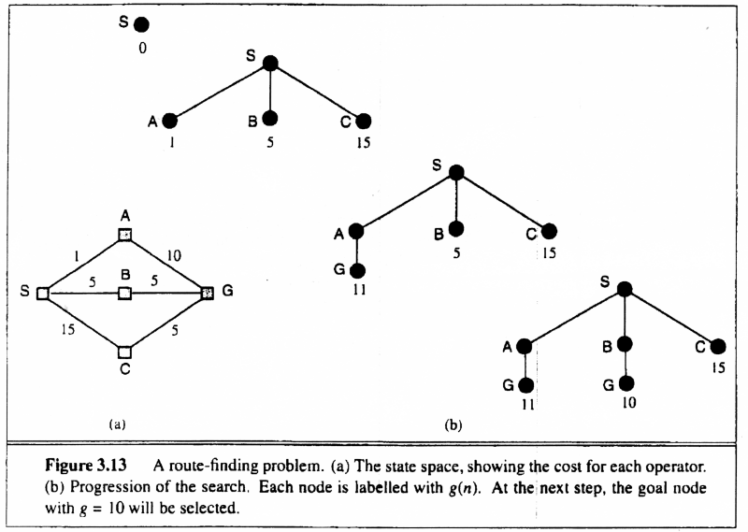
Uniform-cost search: node with smallest path cost g(n).
Proof of Completeness:
Given that every step will cost more than 0,
and assuming a finite branching factor, there
is a finite number of expansions required before
the total path cost is equal to the path cost of the
goal state. Hence, we will reach it.
Proof of optimality given completeness:
Assume UCS is not optimal.
Then there must be an (optimal) goal state with
path cost smaller than the found (suboptimal) goal
state (invoking completeness).
However, this is impossible because UCS would
have expanded that node first by definition.
Contradiction.
A route –finding problem. (a) The state space showing the cost for each operator. (b) Progression of the search.

Slide 22
Uniform-cost search
Implementation: Frontier = queue ordered by path cost. Equivalent to breadth-first if all step costs all equal.
Complete? Yes, if b is finite and step cost ≥ ε > 0.
(otherwise it can get stuck in infinite loops)
Time? # of nodes with path cost ≤ cost of optimal solution.
O(b^{⎣1+C*/ε⎦}) ≈ O(b^{d+1})
Space? # of nodes with path cost ≤ cost of optimal solution.
O(b^{⎣1+C*/ε⎦}) ≈ O(b^{d+1})
Optimal? Yes, for any step cost ≥ ε > 0.

Slide 23
Uniform-cost search
6
1
A
D
F
3
1
S
2
4
8
G
B
E
1
C
20
The graph above shows the step-costs for different paths going from the start (S) to the goal (G).
Use uniform cost search to find the optimal path to the goal.

Slide 24
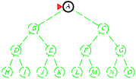
Depth-first search
Expand deepest unexpanded node
Frontier = Last In First Out (LIFO) queue, i.e., new successors go at the front of the queue.
Goal-Test when inserted.
Future= green dotted circles
Frontier=white nodes
Expanded/active=gray nodes
Forgotten/reclaimed= black nodes
Initial state = A
Is A a goal state?
Put A at front of queue.
frontier = [A]

Slide 25
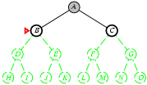
Depth-first search
Expand deepest unexpanded node
Frontier = LIFO queue, i.e., put successors at front
Future= green dotted circles
Frontier=white nodes
Expanded/active=gray nodes
Forgotten/reclaimed= black nodes
Expand A to B, C.
Is B or C a goal state?
Put B, C at front of queue.
frontier = [B,C]
Note: Can save a space factor of b by generating successors one at a time.

Slide 26
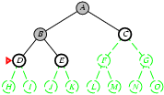
Depth-first search
Expand deepest unexpanded node
Frontier = LIFO queue, i.e., put successors at front
Future= green dotted circles
Frontier=white nodes
Expanded/active=gray nodes
Forgotten/reclaimed= black nodes
Expand B to D, E.
Is D or E a goal state?
Put D, E at front of queue.
frontier = [D,E,C]

Slide 27
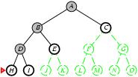
Depth-first search
Expand deepest unexpanded node
Frontier = LIFO queue, i.e., put successors at front
Future= green dotted circles
Frontier=white nodes
Expanded/active=gray nodes
Forgotten/reclaimed= black nodes
Expand D to H, I.
Is H or I a goal state?
Put H, I at front of queue.
frontier = [H,I,E,C]

Slide 28
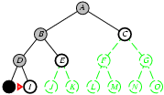
Depth-first search
Expand deepest unexpanded node
Frontier = LIFO queue, i.e., put successors at front
Future= green dotted circles
Frontier=white nodes
Expanded/active=gray nodes
Forgotten/reclaimed= black nodes
Expand H to no children.
Forget H.
frontier = [I,E,C]

Slide 29
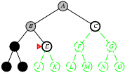
Depth-first search
Expand deepest unexpanded node
Frontier = LIFO queue, i.e., put successors at front
Future= green dotted circles
Frontier=white nodes
Expanded/active=gray nodes
Forgotten/reclaimed= black nodes
Expand I to no children.
Forget D, I.
frontier = [E,C]

Slide 30
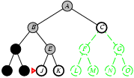
Depth-first search
Expand deepest unexpanded node
Frontier = LIFO queue, i.e., put successors at front
Future= green dotted circles
Frontier=white nodes
Expanded/active=gray nodes
Forgotten/reclaimed= black nodes
Expand E to J, K.
Is J or K a goal state?
Put J, K at front of queue.
frontier = [J,K,C]

Slide 31
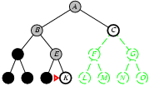
Depth-first search
Expand deepest unexpanded node
Frontier = LIFO queue, i.e., put successors at front
Future= green dotted circles
Frontier=white nodes
Expanded/active=gray nodes
Forgotten/reclaimed= black nodes
Expand I to no children.
Forget D, I.
frontier = [E,C]

Slide 32
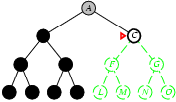
Depth-first search
Expand deepest unexpanded node
Frontier = LIFO queue, i.e., put successors at front
Future= green dotted circles
Frontier=white nodes
Expanded/active=gray nodes
Forgotten/reclaimed= black nodes
Expand K to no children.
Forget B, E, K.
frontier = [C]

Slide 33
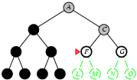
Depth-first search
Expand deepest unexpanded node
Frontier = LIFO queue, i.e., put successors at front
Future= green dotted circles
Frontier=white nodes
Expanded/active=gray nodes
Forgotten/reclaimed= black nodes
Expand C to F, G.
Is F or G a goal state?
Put F, G at front of queue.
frontier = [F,G]

Slide 34
Properties of depth-first search
Time? O(b^{m}) with m =maximum depth of space
Terrible if m is much larger than d
If solutions are dense, may be much faster than BFS
Space? O(bm), i.e., linear space!
Remember a single path + expanded unexplored nodes
Optimal? No: It may find a non-optimal goal first
A
B
C

Slide 35
Properties of depth-first search
Complete? No: fails in loops/infinite-depth spaces
Can modify to avoid loops/repeated states along path
check if current nodes occurred before on path to root
Can use graph search (remember all nodes ever seen)
problem with graph search: space is exponential, not linear
Still fails in infinite-depth spaces (may miss goal entirely)
A
B
C

Slide 36
Depth Limit Search
Depth limited search is an uninformed search algorithm which is similar to Depth First Search(DFS). It can be considered equivalent to DFS with a predetermined depth limit 'l'. Nodes at depth l are considered to be nodes without any successors.
Depth limited search may be thought of as a solution to DFS's infinite path problem; in the Depth limited search algorithm, DFS is run for a finite depth 'l', where 'l' is the depth limit.

Slide 37
Depth Limit Search
By incorporating a specified limit termed as the depth limit, the Depth Limited Search Algorithm eliminates the issue of the DFS algorithm's infinite path problem; In a graph, the depth limit is the point beyond which no nodes are explored

Slide 38
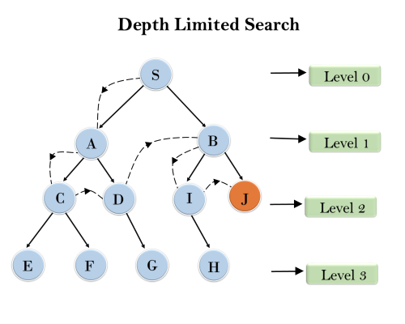
Example:

Slide 39
Depth Limit Search
Advantages:
Depth-limited search is Memory efficient.
Disadvantages:
Depth-limited search also has disadvantage of incompleteness.
It may not be optimal if the problem has more than one solution.

Slide 40
Depth Limit Search
Completeness: DLS search algorithm is complete if the solution is above the depth-limit.
Optimality: Even if l>d, depth-limited search is not ideal.
Time Complexity: O(b^l) where b is known as the branching factor (number of children at each node) and l is the given depth limit.
Space Complexity: O(b.l) where b is known as the branching factor (number of children at each node) and l is the given depth limit.

Slide 41
Bidirectional Search
Bidirectional Search is an algorithm that simultaneously searches forward from the initial state and backward from the goal state until the two searches meet.
This method can significantly reduce the search time, as each search only needs to explore half the depth of the search space.
Bidirectional search can use search techniques such as BFS, DFS, DLS, etc.
This approach can significantly reduce the search space and improve efficiency compared to unidirectional search methods.

Slide 42
Steps of Bidirectional Search
1. Initialization:
Start two separate searches: one from the initial node (source) and one from the goal node (target).
Use two sets (or queues) to keep track of the nodes to be explored from each direction.
2. Expansion:
Alternately expand nodes from each search front.
For the forward search, expand the next node and add its neighbors to the forward set.
For the backward search, expand the next node and add its neighbors to the backward set.

Slide 43
Steps of Bidirectional Search
3. Intersection Check:
After each expansion, check if there is any common node in both search fronts.
If a common node is found, the search terminates, and a path is reconstructed by joining the paths from the initial node to the common node and from the goal node to the common node.
4. Path Reconstruction:
Trace back from the meeting node to the initial node and from the meeting node to the goal node to reconstruct the complete path.

Slide 44
Example
Consider a simple undirected graph with nodes labeled A, B, C, D, E, and F.
We want to find the shortest path from node A to node F.
A
B
C
D
E
F

Slide 45
Example
Initialization:
Forward set: {A}
Backward set: {F}
Expansion:
Forward from A: Backward from F:
Expand A: {A -> B, A -> C} Expand F: {F -> E}
Forward set: {B, C} Backward set: {E}

Slide 46
Example
Second Expansion:
Forward from B:
Expand B: {B -> D}
Forward set: {C, D}
Backward from E:
Expand E: {E -> D}
Backward set: {D}
3. Intersection Check:
Common node found: D

Slide 47
Example
4. Path Reconstruction:
Path from A to D: A -> B -> D
Path from F to D: F -> E -> D
Combine paths: A -> B -> D -> E -> F
Thus, the shortest path from A to F using Bidirectional Search is
A -> B -> D -> E -> F.

Slide 48
Bidirectional Search
Advantages:
Bidirectional search is fast.
Bidirectional search requires less memory
Disadvantages:
Implementation of the bidirectional search tree is difficult.
In bidirectional search, one should know the goal state in advance.

Slide 49
Bidirectional Search
Completeness: Bidirectional search is complete if both searches use an algorithm like BFS.
Optimality: Bidirectional search is optimal if both searches use BFS and all step costs are equal.
Time Complexity: O(b^(d/2)), where b is the branching factor and d is the depth of the solution. This is exponentially faster than O(b^d).
Space Complexity: O(b^(d/2)), as it needs to store the nodes at the frontier of both searches.

Slide 50
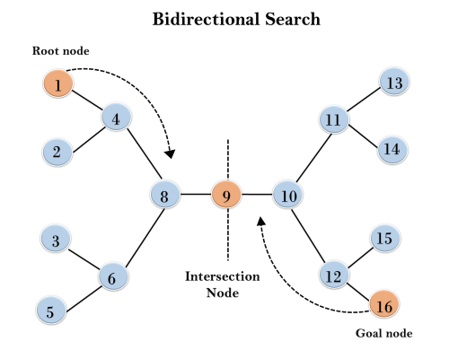
Bidirectional Search

Slide 51
Summary of algorithms
Criterion | Breadth-First | Uniform-Cost | Depth-First | Depth-Limited | Iterative Deepening DLS | Bidirectional (if applicable)
Complete? | Yes[a] | Yes[a,b] | No | No | Yes[a] | Yes[a,d]
Time | O(b^{d}) | O(b^{⎣1+C*/ε⎦}) | O(b^{m}) | O(b^{l}) | O(b^{d}) | O(b^{d/2})
Space | O(b^{d}) | O(b^{⎣1+C*/ε⎦}) | O(bm) | O(bl) | O(bd) | O(b^{d/2})
Optimal? | Yes[c] | Yes | No | No | Yes[c] | Yes[c,d]

Slide 52
Summary
Problem formulation usually requires abstracting away real-world details to define a state space that can feasibly be explored
Variety of uninformed search strategies
Iterative deepening search uses only linear space and not much more time than other uninformed algorithms

Slide 53
REFERENCES FOR FURTHER LEARNING OF THE SESSION
Reference Books:
1. Artificial Intelligence Russel and Norvig 3rd Edition Pearson Education, PHI, (2015)
2. Artificial Intelligence Elaine Rich & Kevin Knight 3rd Edition Tata McGraw-Hill Edition, Reprint (2008)
Sites and Web links:
1. https://www.javatpoint.com/ai-uninformed-search-algorithms
2. https://www.geeksforgeeks.org/search-algorithms-in-ai/

Slide 54
Self-Assessment Questions
1. Iterative Deepening Search (IDS) combines the benefits of which two search strategies?
A) Breadth-First Search and Depth-First Search B) Depth-First Search and Uniform-Cost Search
C) Breadth-First Search and Uniform-Cost Search D) Depth-Limited Search and BF Search
2. Which of the following strategies is least likely to be affected by high branching factors?
A) Breadth-First Search B) Depth-First Search C) Uniform-Cost Search D) Iterative Deepening Search

Slide 55
Self-Assessment Questions
3. What is Depth-Limited Search (DLS)?
a. A variation of depth-first search with a limit on the depth of Search tree
b. A variation of breadth-first search with a limit on the number of nodes
c. An uninformed search that uses a priority queue
d. A search algorithm that guarantees finding the shortest path

Slide 56
Self-Assessment Questions
4. Which data structure is typically used in Least-Cost Search to keep track of
nodes?
a. Stack
b. Queue
c. Priority Queue
d. Hash Table

Slide 57
Self-Assessment Questions
5. How does Bidirectional Search improve efficiency?
a. By exploring in only one direction
b. By exploring from both the initial state and the goal state simultaneously
c. By using a larger memory space
d. By ignoring the goal state initially

Slide 58
TERMINAL QUESTIONS
1. What are the main characteristics of an uninformed search strategy?
2. Explain the Iterative Deepening Depth-First Search (IDDFS). Why might it be preferred over both BFS
and DFS?
3. Compare BFS and DFS in terms of completeness, time complexity, space complexity, and optimality.
4. In what scenarios would Uniform Cost Search be more appropriate than other uninformed search
strategies?
5. What are the limitations of using uninformed search strategies in real-world problems?

Slide 59
THANK YOU
TEAM AI&ML

